Slide 1

DAISY
SENSING BIODIVERSITY
USER MANUAL

Slide 2
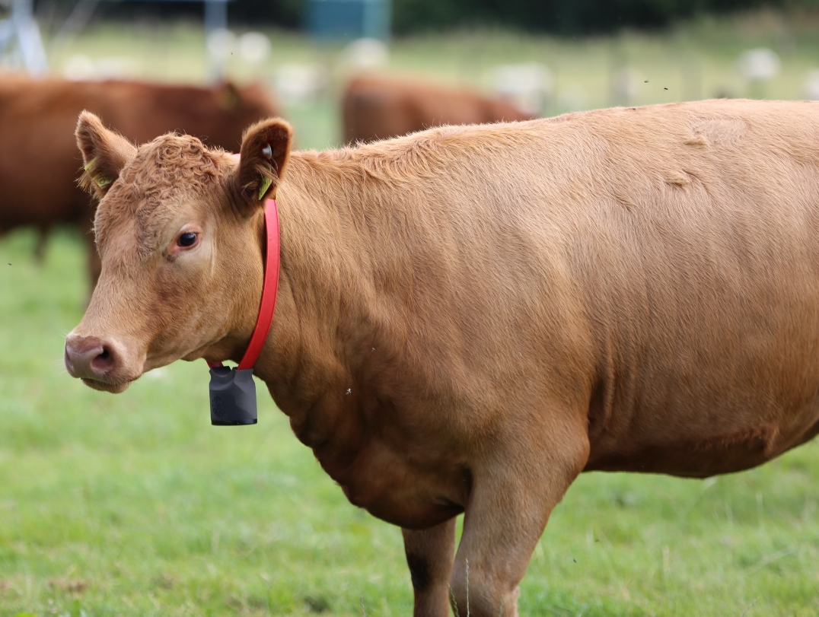

CONTENTS
PAGE
3
5
6
7
12
16
WHAT IS DAISY?
COMPONENTS
QUICK GUIDE
SET UP GUIDE
DATA ANALYSIS
DISPOSAL

Slide 3
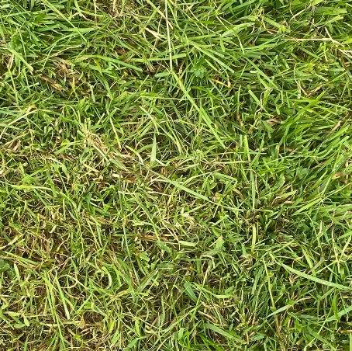
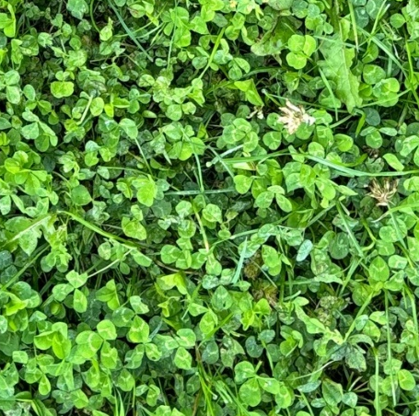
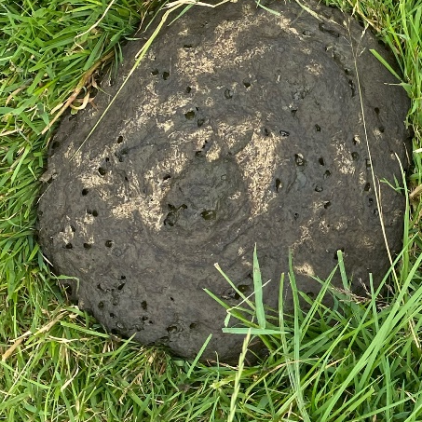
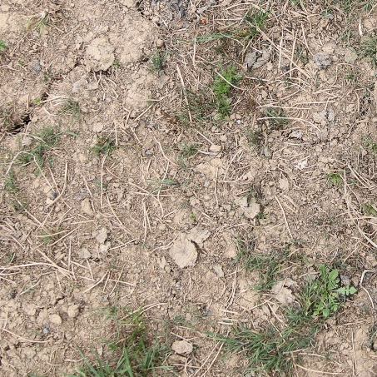
WHAT IS DAISY?
At DAISY we understand how field biodiversity goes on to impact environmental goals as well as livestock grazing patterns, livestock rotation and field resowing. We set out to quantify four key field indicators and display these in a useful interface to allow you to understand your fields better.
Using the DAISY cow bell mounted to a cow collar, distributions of grass, clover, dung and bare soil can be monitored.
GRASS
CLOVER
BARE
SOIL
DUNG

Slide 4
CATTLE MOUNTED
Traditional ecological surveying is labour-intensive and rarely performed on farms despite the crucial field insights that such data could provide. DAISY uses the roaming cattle to passively image and understand the field composition.
A CLASSIC DESIGN
The DAISY device utilises the iconic cow bell design allowing it to hang from a collar and capture clear pictures of the field with minimal disturbance to the cow.
AI POWERED
Pictures are analysed by machine learning algorithms to understand the composition of your field to a high level of certainty.
CONVENIENT
The data collected from our algorithms is shared with you via an interactive interface allowing you to understand the vegetation of your field and how it maps to other field characteristics such as soil class and topography.

Slide 5
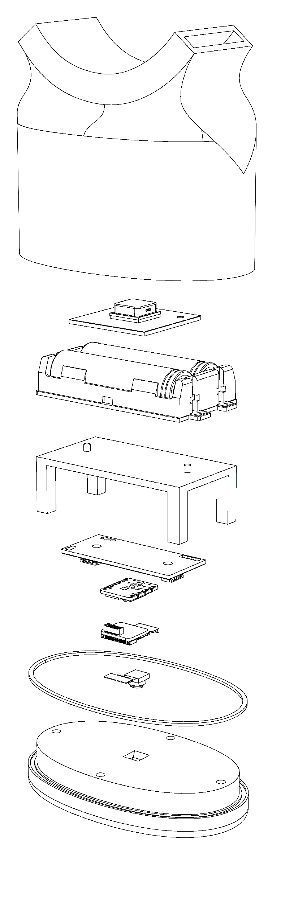
COMPONENTS
Collar
Slot
Exterior
Casing
Batteries
GPS
Battery
Holder
Table
PCB
MCU
Camera
Gasket
Bottom
Piece
SPECIFICATIONS
Dimensions
Weight
Battery Life
Charge Time
GPS Accuracy
100 cm x 120 cm x 70 cm
~ 450 g
~ 10 days
~ 1 hours
± 1.5 m *
*As cited by u-blox for the SAM-M10Q antenna module.
N.B. This may differ experimentally.

Slide 6
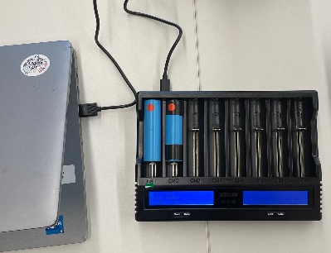
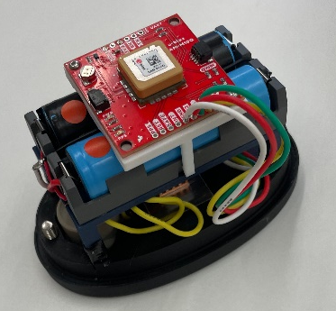
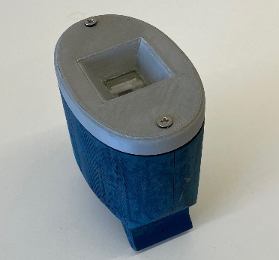
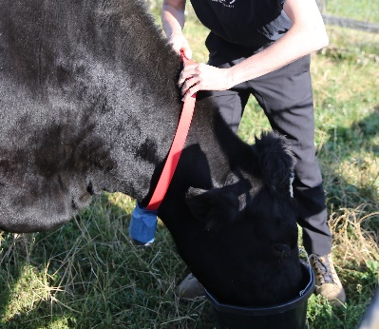
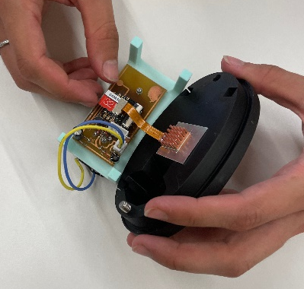
QUICK GUIDE
STEP 1:
CHARGE THE DEVICE
STEP 2:
ASSEMBLE THE DAISY
COWBELL
STEP 3:
ATTCH TO CATTLE
STEP 4:
LEAVE TO SAMPLE FIELD
STEP 5:
DETACH AND REMOVE
THE SD CARD
STEP 6:
USE OUR CUSTOM INTERFACE TO UNDERSTAND YOUR FIELD

Slide 7
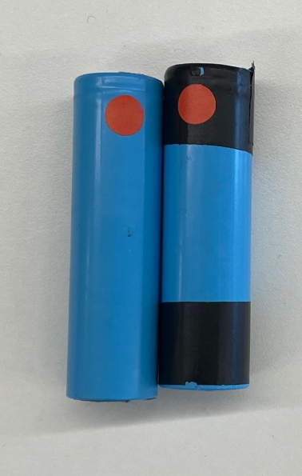
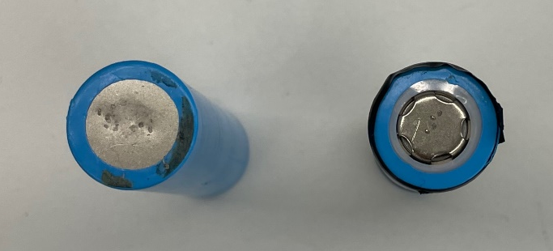

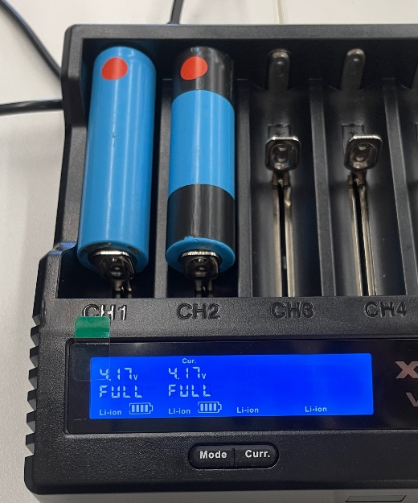
SET UP
STEP 1: CHARGE THE DEVICE
POSITIVE
Identify the positive end of the batteries via the attached sticker or the distinct end shapes.
POSITIVE
NEGATIVE
NEGATIVE
Plug the provided charger into a computer. Insert the batteries into the charger. Continue to charge until the display flashes ‘FULL’. This should take approximately 1 hour from empty.

Slide 8
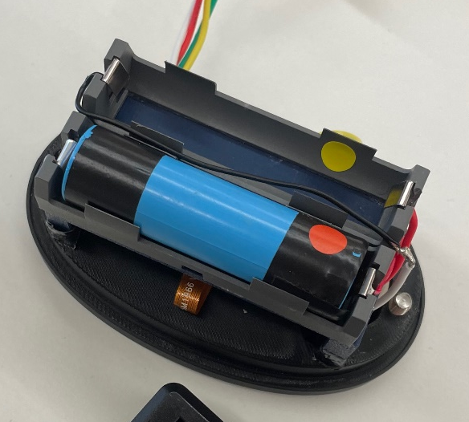
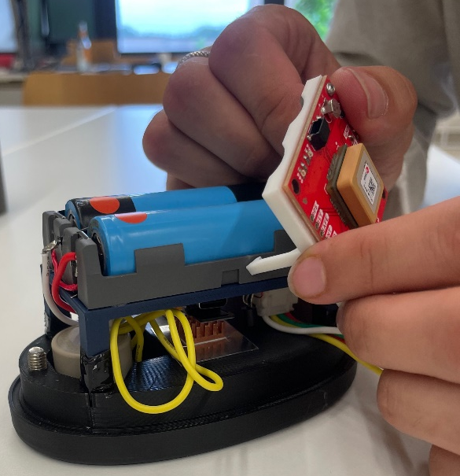

SET UP
STEP 2: ASSEMBLE THE DAISY COW BELL
(INTERIOR)
Insert the charged batteries into the battery component matching up the positive end of the battery with the sticker on the interior of the component.
Click the legs of the GPS unit into the notches in the side of the battery component.
Gently tuck exposed wires underneath the battery component.

Slide 9
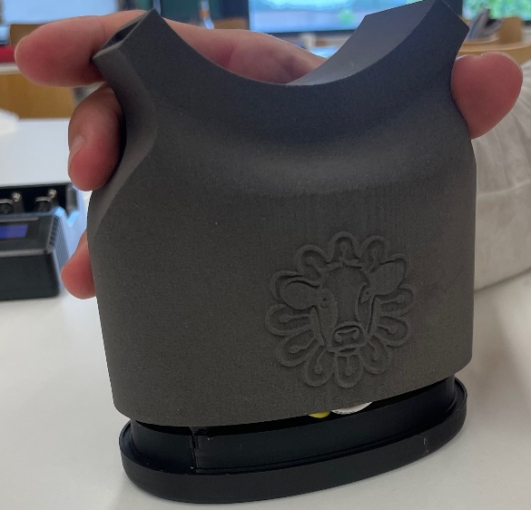
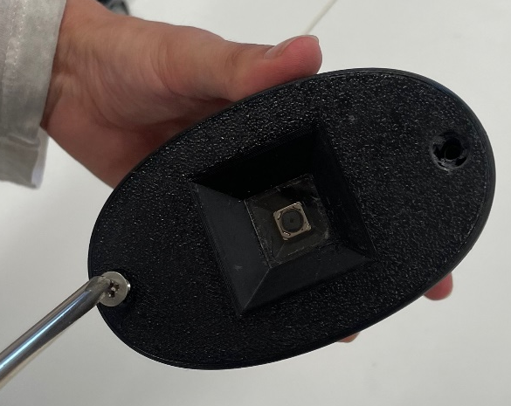
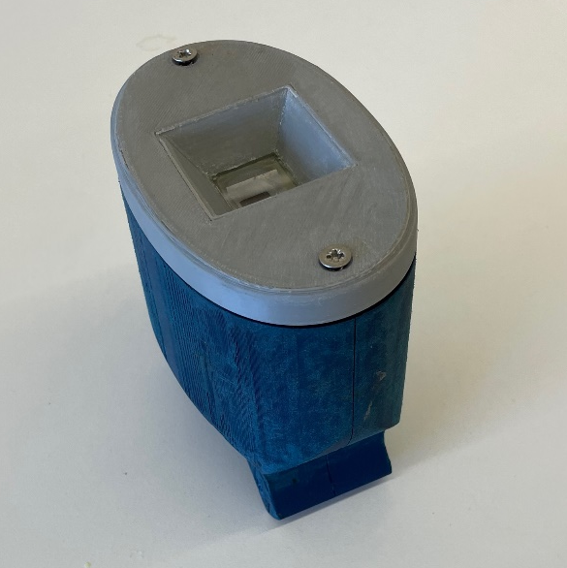
SET UP
STEP 2: ASSEMBLE THE DAISY COW BELL
(EXTERIOR)
Lower the exterior casing onto the base.
Use a Phillips head screwdriver to secure the two parts together with screws.
Keep the device upside down until you are ready to use it.

Slide 10
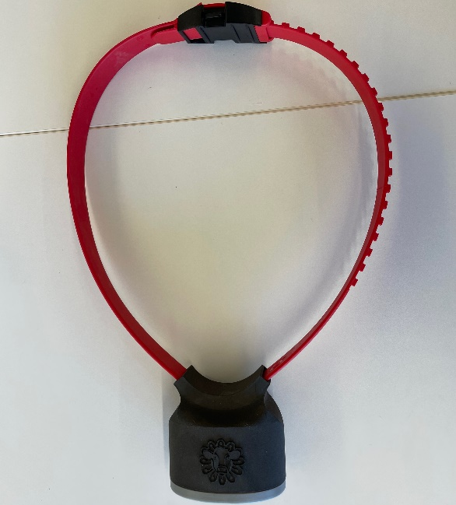
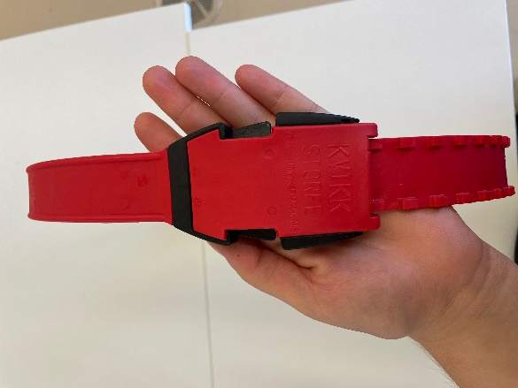

SET UP
STEP 3: ATTACH TO CATTLE
Being careful to maintain the device upside down, slide the collar through the openings in the DAISY bell.
At DAISY we recommend using a collar with a fast attach/detach system for easy removal in the case of an emergency.
Attach the collar to the cow of choice. Attachment to a cow which has been observed to be more dominant is ideal.

Slide 11
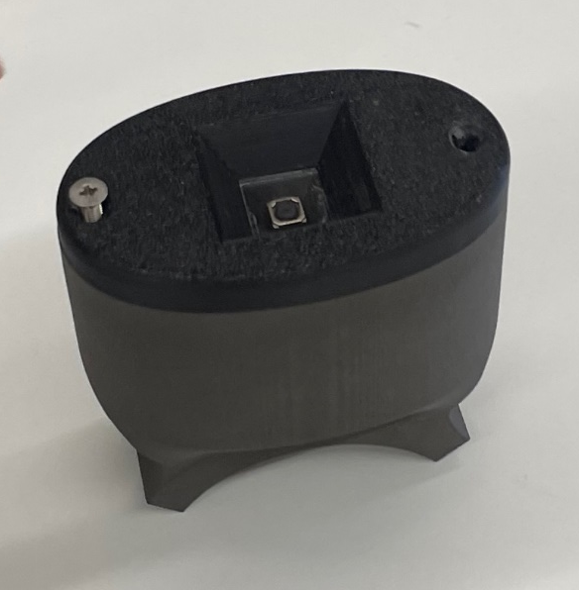

SET UP
STEP 4: LEAVE DAISY TO SAMPLE THE FIELD
The DAISY collar has been designed for prolonged field sampling.
STEP 5: DETACH DAISY AND REMOVE
THE SD CARD
Once removed from its collar, maintain the device upside-down. Remove the screws and slide off the cover.
Lift the table from its place in the base component.
Gently remove the SD card.

Slide 12
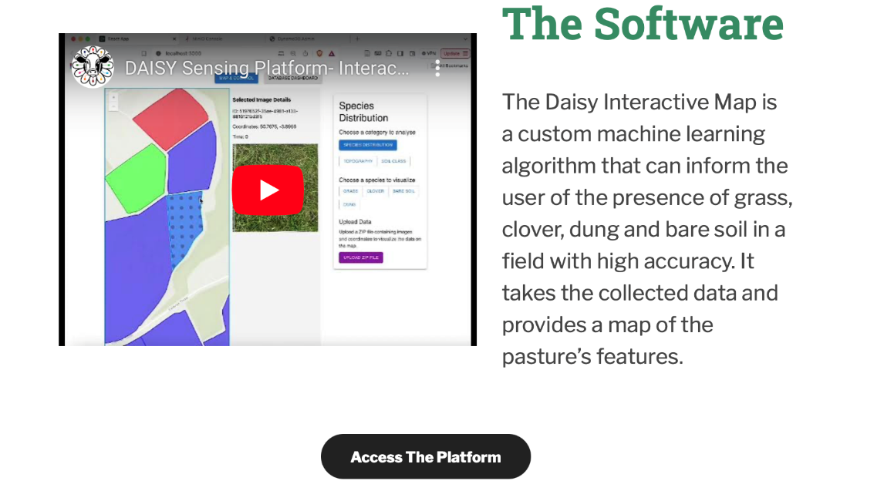

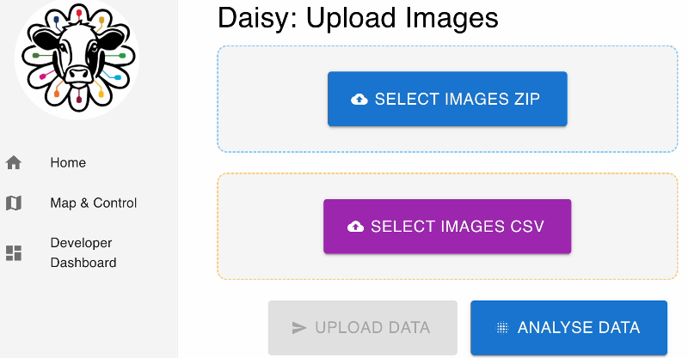
DATA ANALYSIS
STEP 1: ACCESS THE PLATFORM VIA
WWW.DAISYSENSING.COM
STEP 2: UPLOAD ZIP AND CSV FILES FROM THE SD CARD. UPLOAD DATA AND CLICK ANALYSE DATA.

Slide 13
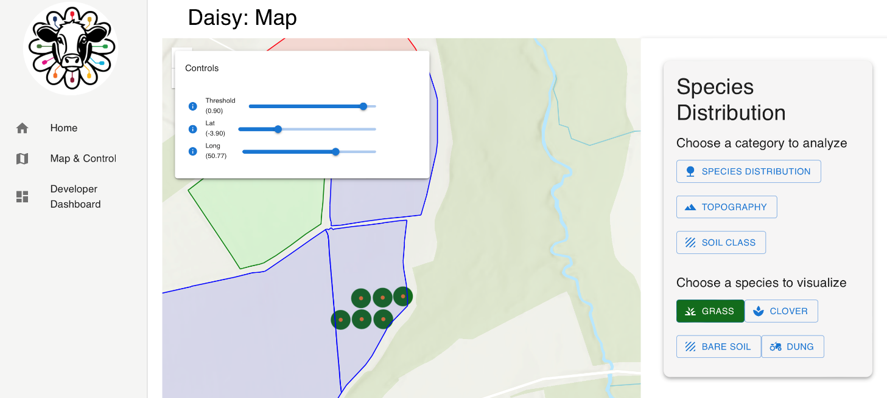
DATA ANALYSIS
STEP 3: NAVIGATE TO ‘MAP AND CONTROL’ TO VISUALISE YOUR FIELD
The DAISY map aids to visualize the images taken of your field. Here you may choose which type of field characteristics you would like to analyze along with which identified species you would like to visualize.
In the example, all the uploaded images contain grass as is indicated by the green circles surrounding the data points.

Slide 14
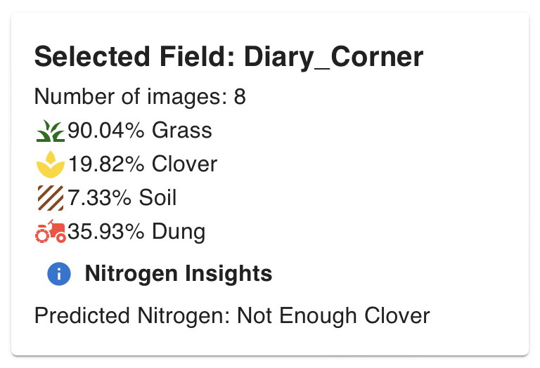
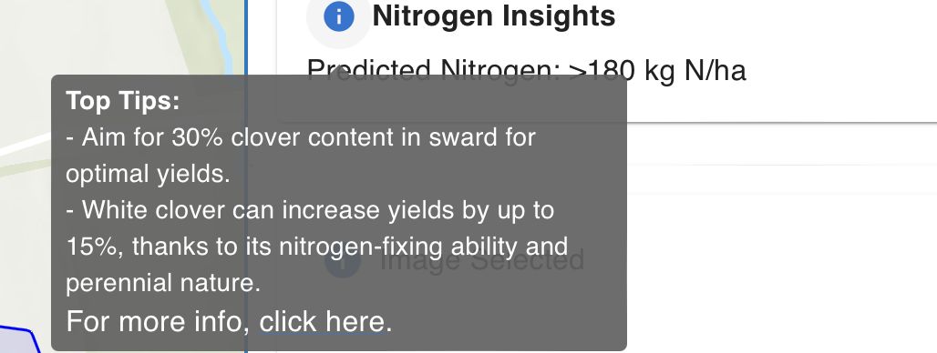
DATA ANALYSIS
STEP 4: SELECT A FIELD TO INVESTIGATE
The proportion of images in which each category has been found is summarized on the right-hand side.
When sufficient images containing clover have been captured, nitrogen insights will become available.

Slide 15
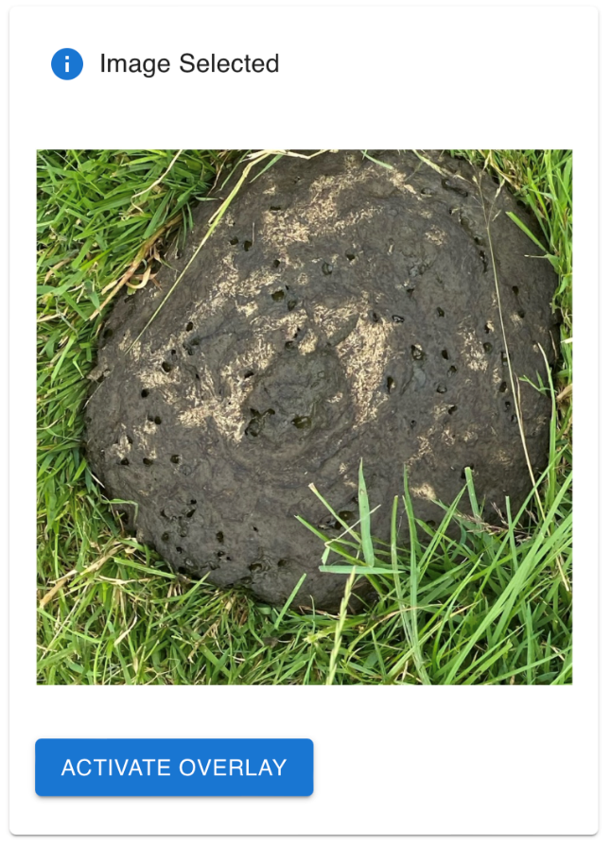
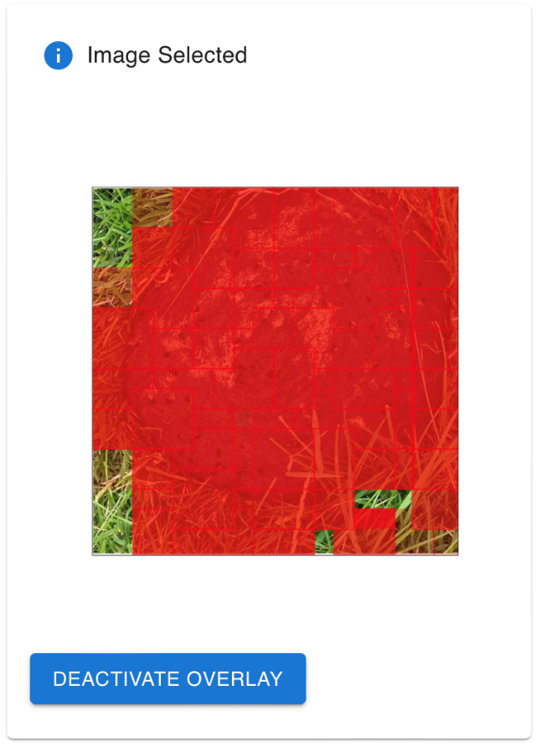
DATA ANALYSIS
STEP 5: SELECT AN IMAGE TO INVESTIGATE. SELECT ACTIVATE OVERLAY
To investigate how DAISY has classified an image into a specific category, select ‘ACTIVATE OVERLAY’. The red overlay indicates where DAISY has predicted that this category exists in the image. The more intense the red square, the higher the probability.
In the example, the category of interest was dung.

Slide 16
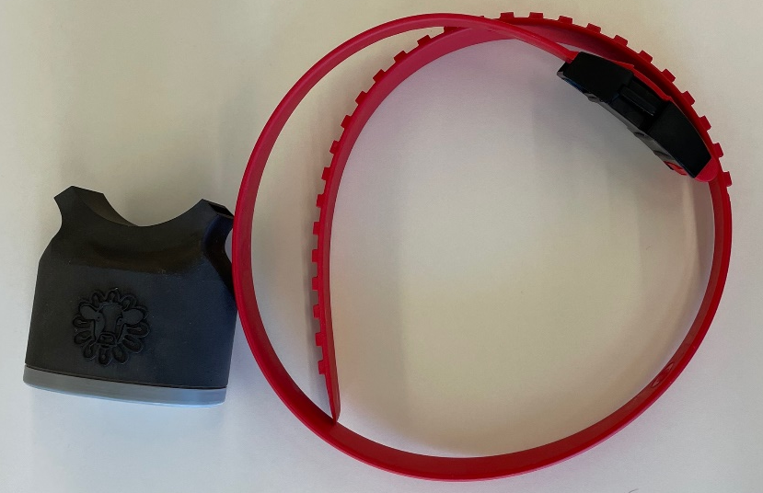
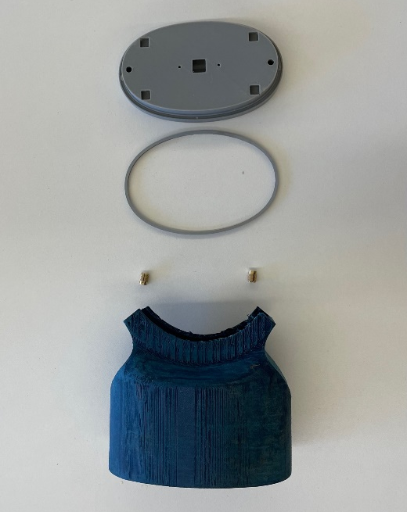
DISPOSAL
STEP 1: REMOVE COLLAR AND
DETACH OUTER CASE
Remove the collar from the cow and slide off the sensor.
Collar slip:
Nylon
Recyclable
Remove the brass threaded inserts and rubber O-rings to detach the sensor casing from the collar slip.
Gasket:
Rubber
Recyclable
Casing:
Nylon
Recyclable
Screws:
Brass
Recyclable

Slide 17
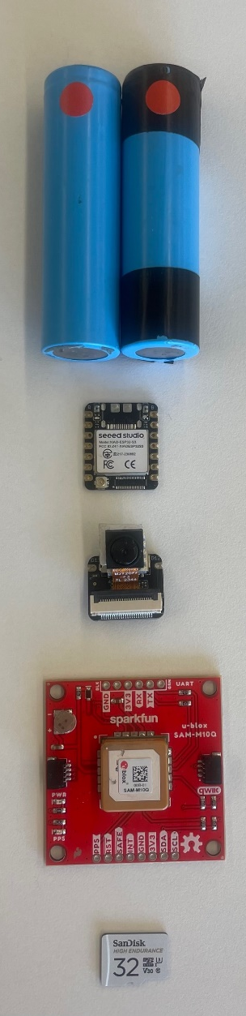
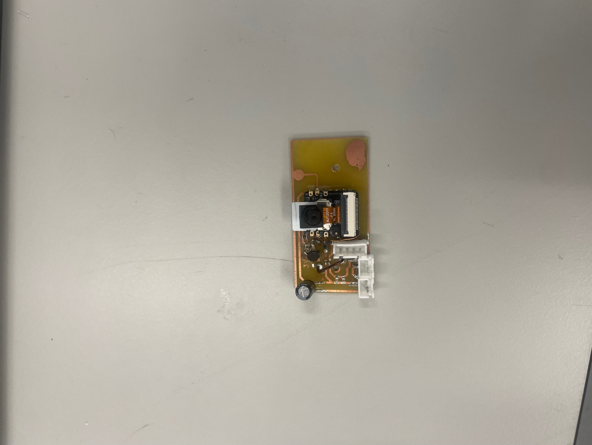
DISPOSAL
STEP 2: REMOVE AND RECYCLE
ELECTRONIC COMPONENTS
Unclip the camera and SD card. Desolder the microcontroller from the printed circuit board (PCB). Remove the batteries and GPS from their fitted components
Recycle each component, along with the PCB, as E-waste.
Batteries
Microcontroller
unit
Camera unit
GPS unit
PCB
SD card

Slide 18
DISPOSAL
GUIDELINES BY COMPONENT
Component(s) | Classification | UK Guidelines
Casing (Nylon) Collar slip (Nylon) | Plastic waste Non-hazardous Recyclable UK Waste code: 17-02-03 | GOV UK Plastic Waste
O-rings (Rubber) | Consumer waste Non-hazardous Recyclable | Gov UK Consumer Waste
Threaded inserts (Brass) | Metallic waste Non-hazardous Recyclable UK Waste code: 17-04-01 | Gov UK Metallic Waste
Camera | Category 4 E-waste: Consumer equipment Recyclable | Gov UK E-Waste
Battery GPS Micro-controller SD card | Category 3 E-waste: IT and telecommunications equipment Recyclable | Gov UK E-Waste
Alternatively, repurpose your device using DAISY’s open-source code.
This can be found at WWW.DAISYSENSING.COM

Slide 19
DAISY was created as the 2024 Team Challenge Project under the Centre for Doctoral Training in Sensor Technologies and Applications for a Healthy and Sustainable Future. DAISY was created by the 2023/24 student cohort in collaboration with Rothamsted Research.
This project was funded by the EPSRC through the Centre for Doctoral Training in Sensor Technologies and Applications for a Healthy and Sustainable Future.
August 2024

